Slide 1
Angular Directives
Narmatha & Meghana

Slide 2
Agenda
Introduction
Angular Directives
Types of Directives
Why Directives

Slide 3
Introduction
Angular directives are markers on the HTML elements that tell Angular how to behave or manipulate the DOM (Document Object Model) at runtime.
They are used to extend HTML with new attributes and elements, allowing you to create dynamic and interactive web applications.

Slide 4
What are Angular Directives?
In Angular, Directives are defined as classes that can add new behavior to the elements in the template or modify existing behavior.

Slide 5
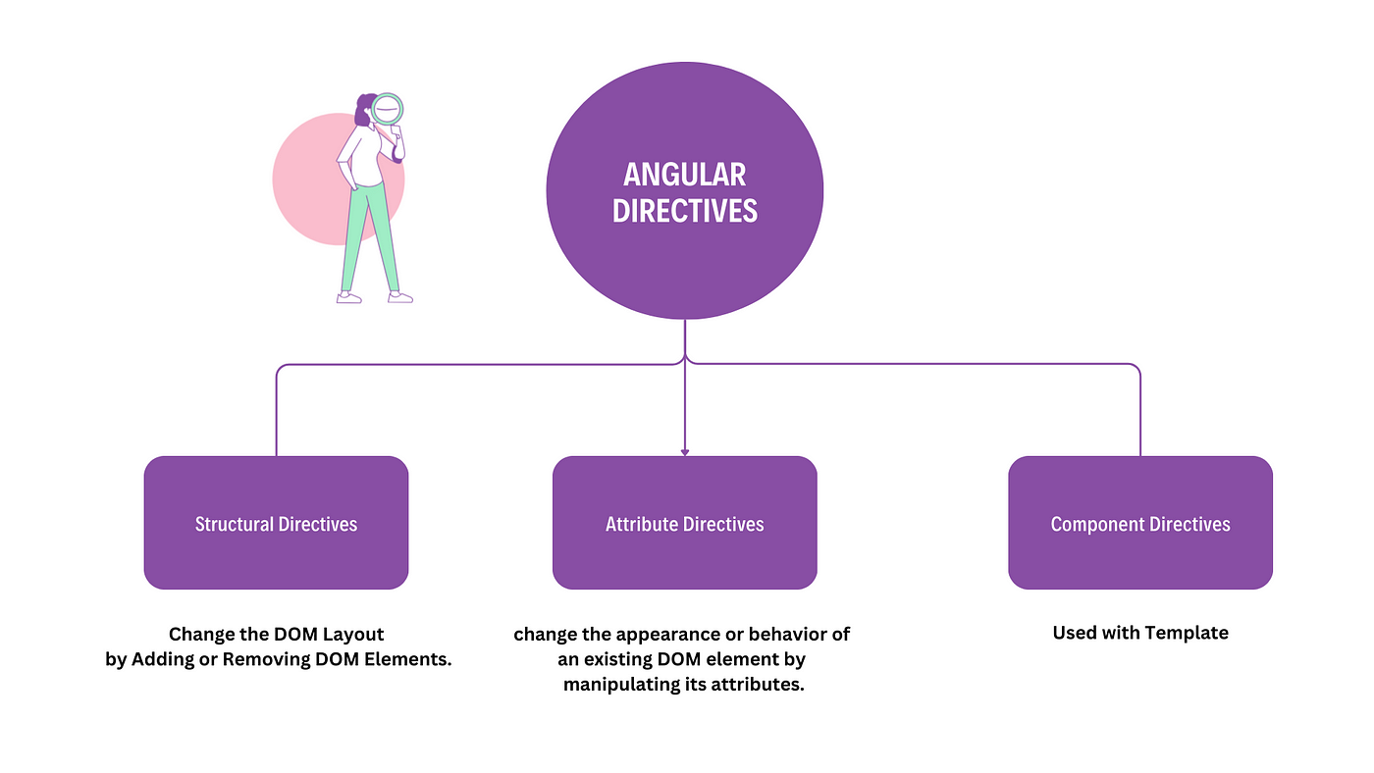
TYPES OF DIRECTIVES

Slide 6
Types of directives
COMPONENT
STRUCTURAL
ATTRIBUTE
*ngIf
*ngFor
*ngSwitch
ngClass
ngStyle

Slide 7
COMPONENT DIRECTIVE
The Component is also a type of directive in angular with its own template, styles, and logic needed for the view.
The Component Directive is the most widely used directive in the angular application.
A component is a fundamental building block of an Angular application and you cannot create an angular application without a component.

Slide 8
Structural DIRECTIVE
Structural directives start with a * sign.
These directives are used to manipulate and change the structure of the DOM elements.
*ngIf directive
*ngSwitch directive
*ngFor directive.

Slide 9
ATTRIBUTE DIRECTIVE
In Angular, an attribute directive is a type of directive that is applied to an HTML element as an attribute.
Attribute Directive is basically used to modify or alter the appearance and behavior of an element without altering its structure.
ngClass
ngStyle

